Slide 1

AUTOMATED STOCK MARKET ETL PIPELINE
Programme
Master in Business Analytics & Data Science
Institution
EU Business School Munich
Lecturer
Dr. Zainab Usman
Academic Year
Spring Semester 2026 (Term III)
Technologies Used
Python | FMP API | Pandas | PostgreSQL | Power BI | Windows Task Scheduler
Business Intelligence Final Assignment
MADSC301 – Business Intelligence
Submitted By: Abin Benno
Student ID: 25061274
GitHub Repository:
https://github.com/abinb23/stock-market-etl

Slide 2
Solution Architecture
ETL Architecture
Financial Modeling Prep (FMP) API ↓ Extract (Python) ↓ Raw JSON Data ↓ Transform (Pandas) ↓ Cleaned Dataset ↓ Load into PostgreSQL ↓ Windows Task Scheduler ↓ Automatic Daily ETL Execution ↓ Updated PostgreSQL Database ↓ Power BI Dashboard
Business Problem
Stock market updates are crucial for investors and analysts to track market performance and spot trends. Manual collection and reporting is time consuming and ineffective.
Proposed Solution
Create an automated ETL pipeline to pull Apple market data and then transform and load the data into PostgreSQL and create the business insights using Power BI.
Technologies
• Python • Requests • Pandas • PostgreSQL • Power BI • Windows Task Scheduler

Slide 3
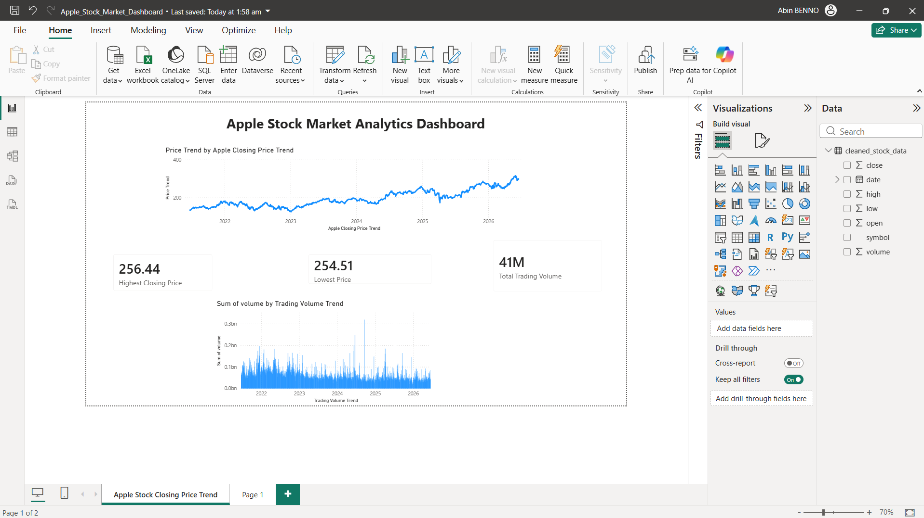
Dashboard Analysis & Business Insights
Key Insights
Apple Stock Price Trend
• Shows overall market performance over time. • Indicates long-term growth trends. • Useful for investment analysis.
Trading Volume Trend
• Highlights investor activity. • Volume spikes periods of increased market interest. • Helps identify unusual market behavior.
Business Value
• Automated stock market monitoring. • Faster decision-making. • Reduced manual reporting effort. • Real-time business intelligence support.
Key Performance Indicators
Highest Closing Price: 256.44
Lowest Price: 254.51
Total Trading Volume: 41M

Slide 4
Automation, Challenges & Future Improvements
Workflow Automation
The ETL pipeline is automated using:
• Windows Task Scheduler • run_etl.bat • Python ETL Scripts
• Daily scheduled execution at 08:00 AM using Windows Task Scheduler.
The task runs automatically every day and updates stock market data without manual intervention.
Challenges Faced
• API Integration • Data Cleaning and Transformation • PostgreSQL Connectivity • Dashboard Design • Workflow Automation
Future Improvements
• Multi-stock Analysis • Real-time Data Streaming • Machine Learning Forecasting • Docker Deployment • Email Alerts for Failures
AI Usage Declaration
GPT was utilized for guidance, structuring code, debugging, and documentation support. I performed all implementation, testing, analysis and project validation.
Conclusion
Successfully created an end to end Business Intelligence solution to automate data extraction, transformation, loading, storing and visualization for stock market analytics.

